Slide 1

Notes:
Just wanted to introduce everyone to my fur babies. What keeps my sanity in check.

Slide 2
Suicide Prevention and Lethal Means
Building a Safer Community

Slide 3
Objectives/Goals
Participants will be able to explain the reasons why reducing access to lethal means can prevent suicide.
Participants will present and understanding of the best strategies for raising the topic of lethal means to individuals that present suicidal concerns
Participants will be able to state specific off-site in-home secure storage options for firearms.
Participants will be able to state specific strategies for limiting access to dangerous medications.
Participants will explain how effectively preventing suicide requires a comprehensive approach that involves families, communities and providers working together to address different aspects of the issue of prevention

Slide 4
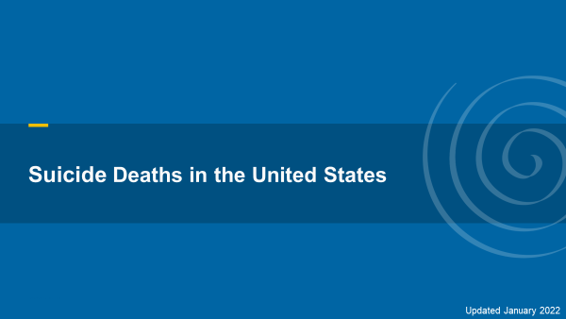

Slide 5
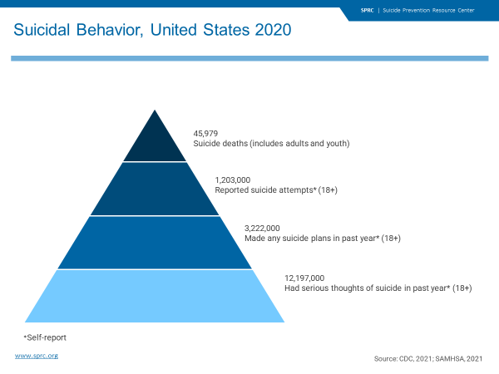
Notes:
Suicide is a significant and tragic national health issue that affects millions of Americans each year. In addition to the more than 48,000 people in the U.S. who died by suicide last year, more than a million attempted suicide and millions more had serious thoughts of suicide (Centers for Disease Control and Prevention [CDC], 2020; Substance Abuse and Mental Health Services Administration [SAMHSA], 2019).

Slide 6
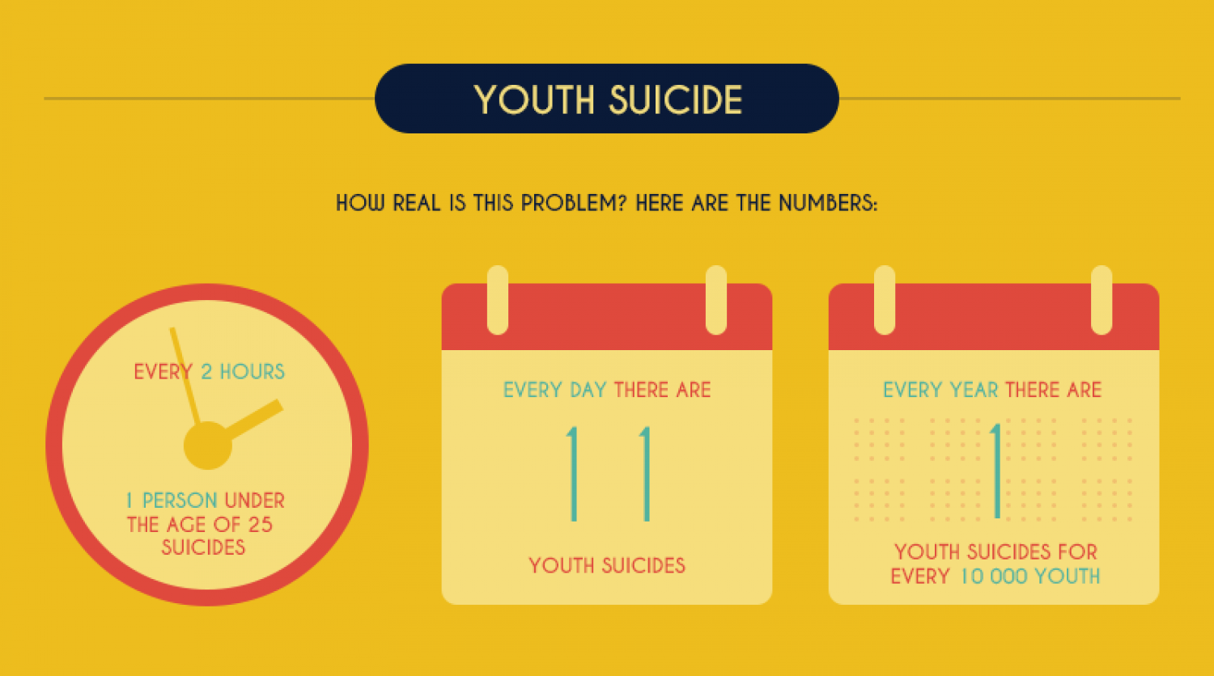

Slide 7
Suicide is a Serious Problem
Myth – Suicide in youth is not a problem
Truth - Suicide in young people is a serious and
prevalent problem:
2nd leading cause of death for young people ages
10-24 and accounts for 20% of all deaths annually

Slide 8
Suicidal Behavior: A Serious
Problem
Rates of other suicidal behavior are high according to a nationally-representative sample of high school students
15.8% seriously considered attempting suicide
12.8% made a plan about how they would attempt suicide
7.8% attempted suicide one or more times
2.4% made a suicide attempt that resulted in an injury, poisoning, or an overdose that required medical attention

Slide 9

Risk and Protective Factors
Risk factors – Increase likelihood that a young person will engage in suicidal behavior
  Intrapersonal, Social/situational, Cultural/environmental
Protective factors – Mitigate or eliminate risk
  Intrapersonal, Social/situational, Cultural/environmental
Consider the balance between the two

Slide 10
Risk Factors: Cultural/Environmental
Stigma associated with asking for help
Barriers to accessing services
Financial costs of services
Cultural and religious beliefs (e.g., belief that suicide is noble resolution of a personal dilemma)
Access to lethal means (i.e. firearms, pills)

Slide 11
Risk Factors: Intrapersonal
Recent or serious loss
Mental disorders (particularly mood disorders)
Hopelessness, helplessness, guilt, worthlessness
Previous suicide attempt
Alcohol and other substance use disorders
Disciplinary problems
High risk behaviors
Sexual orientation confusion

Slide 12

Risk Factors: Social/Situational
Recent or serious loss (e.g., death, divorce, separation, broken relationship)
Family history of suicide
Witnessing family violence
Child abuse or neglect
Lack of social support
Sense of isolation
Victim of bullying
Notes:
Protective factors can include the following: Skills in problem solving, conflict resolution and handling problems in a non-violent way Strong connections to family, friends, and community support
Restricted access to highly lethal means of suicide, Cultural and religious beliefs that discourage suicide and support self, Easy access to a variety of clinical interventions Support through ongoing medical and mental health care relationships

Slide 13

Protective Factors
Skills in problem solving, conflict resolution and handling problems in
a non-violent way
Strong connections to family, friends, and community support
Cultural and religious beliefs that discourage suicide and support self-preservation
Restricted access to highly lethal means of suicide
Notes:
Although addressing and being knowledgeable about the risk factors is important concern must also be given to address Means used when planning for suicide. The data is very high when looking at Lethal means used.

Slide 14
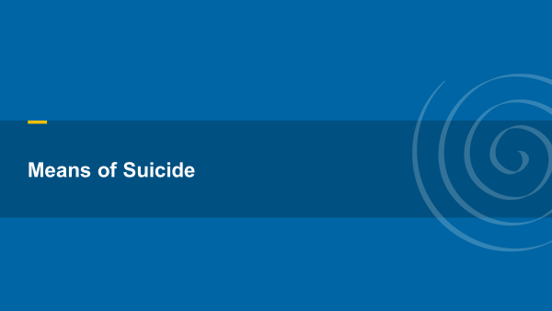

Slide 15
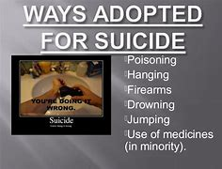

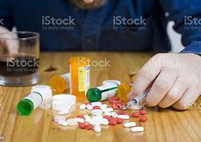
Lethal Mean
A lethal mean refers to a method in which one uses to attempt suicide. The term “lethal” is important because some methods are more harmful or destructive than others. For example, if someone chooses to use a gun to end their life, the act is quick and almost always irreversible.
While suicide may impact groups differently, all suicides have one thing in common—a lethal means was used. Individuals who die by suicide use a variety of means

Slide 16
What Governs Lethality
The first is inherent deadliness. For example, car exhaust with a high CO level will be more deadly than car exhaust with a low CO level.
The second is ease of use. A method that requires technical knowledge is less accessible than one that does not.
The third is accessibility. Given the brief duration of some suicidal crises, a lethal dose of pills in the nightstand poses a greater danger than a prescription that must be hoarded over months to accumulate a lethal dose. Similarly, a gun in the closet poses a greater risk than a very high bridge five miles away, even if both methods have equal lethality if used.
The fourth is ability to abort mid-attempt. More people start an attempt and abort it than carry it through; therefore, methods that can be interrupted without harm mid-attempt — such as overdose, cutting, CO poisoning, and hanging/suffocation — offer a window of opportunity for rescue or change of heart that guns and jumps do not. The fifth factor is acceptability to the attempter. Although fire, for example, is universally accessible, it is rarely used in the U.S. for suicide.

Slide 17
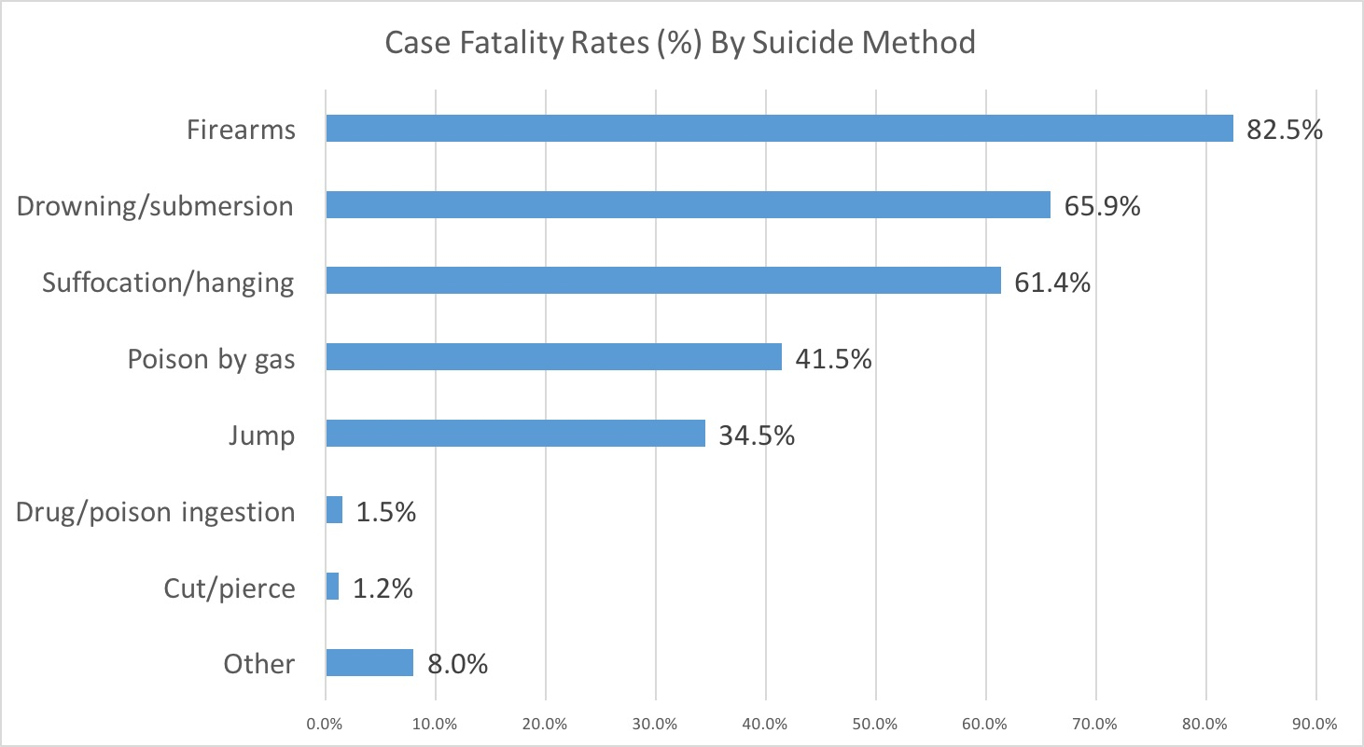
Case Fatality Rates (%) by Suicide Method
Notes:
The bar graph below shows “case fatality” (the percent of people who die in a suicide attempt) for several methods of suicide. It is based on a study that used emergency department data and death certificate data from 8 U.S. states. Firearms have the highest case fatality, and drug/overdose ingestion and cutting have the lowest.
The bar graph below shows “case fatality” (the percent of people who die in a suicide attempt) for several methods of suicide. It is based on a study that used emergency department data and death certificate data from 8 U.S. states. Firearms have the highest case fatality, and drug/overdose ingestion and cutting have the lowest.
Overdose accounts for roughly two-thirds of suicide attempts treated in the hospital,¹ but only a very small proportion (2% or less) prove fatal.² However, some medications are more dangerous than others, especially when taken in combination.³ With over 250,000 attempts annually, at least 5,000 people die each year from an intentional overdose.⁴

Slide 19
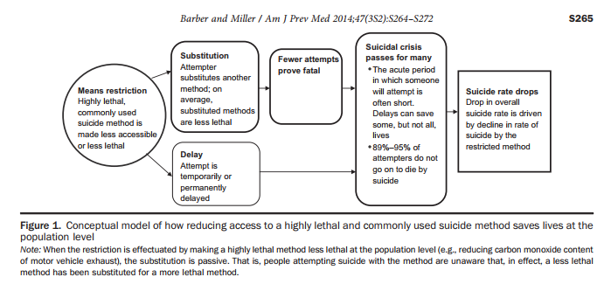
Notes:
Conceptual model describing how reducing access to a highly lethal and commonly used suicide method saves lives at the population level (from Barber & Miller, 2014).
There is relatively strong evidence at the population level that reducing access to, or the toxicity of, a commonly used and highly lethal means is associated with reductions in the overall suicide rate driven by a reduction in the restricted method (Gunnell et al., 2007; Kreitman, 1976; Lubin et al., 2010; Reisch, Steffen, Habenstein, & Tschacher, 2013; Sinyor et al., 2017). When people’s access to a highly lethal means that they would use is blocked, it creates two pathways by which lives are saved (see Figure 1): they may attempt with a method less likely to prove fatal and thus live, or they may not attempt at all.

Slide 20
Restricting Access
Research has shown time and again that restricting access to lethal means or “means restriction” can saves lives.
By restricting access to firearms and other highly lethal methods the decline in suicide rates by that method and overall suicide rates begin to decline.
Restricting access to lethal means does not always lead to fewer deaths but is one suicide prevention measure that merits further research and more individual-level intervention training to make lethal means less readily available.
Approximately 90% of attempters who survive a nonfatal attempt will not go on to die by suicide thereafter.”

Slide 21
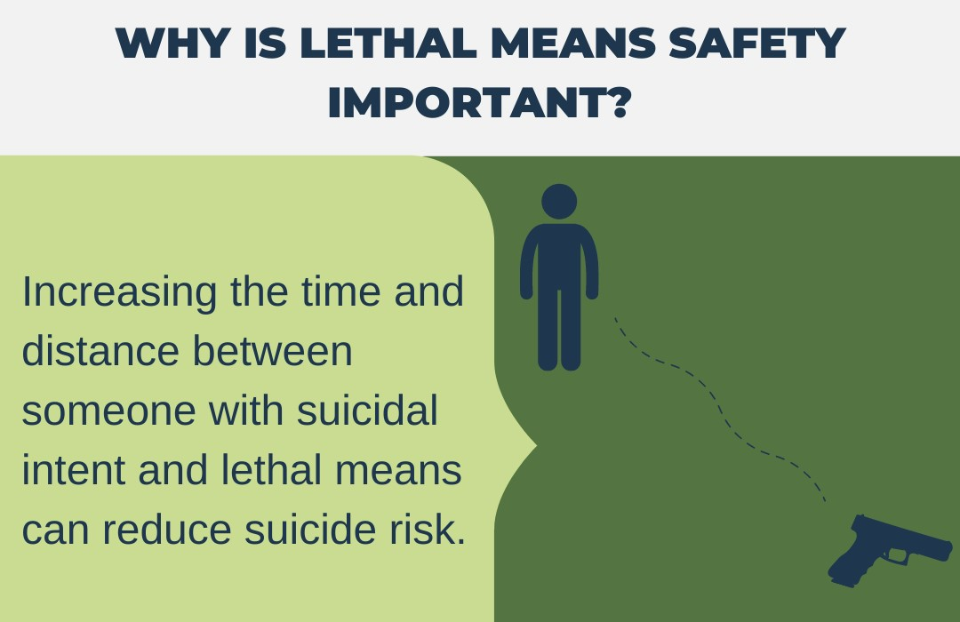

Slide 22
Steps You can Take
There are simple steps you can take to protect yourself and your family.
Individual learn some steps in handling a suicidal crisis (utilize crisis hotline )
Helpful tips for storing guns, medications, and other lethal means
» Medications
Some steps at the policy level have been taken to reduce the risk of medication overdose. Individual pill packets being one of them. However, there are a few steps everyone can take to reduce the risk of an overdose from happening. Those include:
Never keep lethal doses of any medication on hand. Work with your doctor and pharmacist to make sure you have a safe dosage in your home.
Consider keeping medications locked in a safe place.
Properly dispose of medications you no longer need.
» Firearms
Keep firearms locked in a safe and ammunition stored in a separate location.
Ask a friend or family member to store a firearm for you while you work on becoming healthy again.
Check out a local shooting club or local police precinct to see if they have temporary storage options.

Slide 23
Strategic Attempts to Reduce Suicide
Important strides have been made to reduce access to a broad range of lethal means among individuals who may be at risk for suicide. The following strategies highlight effective approaches that have been tested in the United States and other countries. Taken together, these approaches have the potential to reduce suicide and save lives.
Firearms responsibility includes safety technologies and interventions that promote safe storage, such as gun locks and safes; equipping firearm retailers and range owners with the skills to identify individuals who may be at risk for suicide; and asking friends or loved ones to temporarily hold on to firearms during a time of crisis.

Slide 24
Strategic Attempts cont.
Responsible storage consists of:
Keeping firearms locked, and preferably unloaded
Separating firearms and ammunition when not in use.
Secure storage options for gun owners living with individuals who may be at risk for suicide include either storing household guns away from home (e.g., with a relative, at a gun shop, or at a storage facility) or locked at home in a secure gun safe, gun cabinet, or lockbox which the at-risk person has no access
Adding barriers (e.g., fencing, safety nets) to bridges can prevent suicide by making it harder for jumps to occur
Suicide related to railways can be prevented with the installation of barriers blocking access to the tracks.

Slide 25
Recommendations for Communities and Suicide Prevention Groups
Notes:
Encourage statewide and local professional groups and institutions to add a “lethal means counseling” policy to their current suicide prevention protocols to ensure that all suicidal or at-risk individuals and their families are counseled about reducing access to and excess medication guns at home
Train providers who come into contact with people at risk for suicide and their families on how to talk about reducing access to firearms at home
Work with local police and other public safety groups to expand options for families who want to permanently or temporarily remove their guns. Many police departments currently have no policy or protocols in place to dispose of or store firearms and aren’t able to help families.
One way to ensure that at-risk patients and their families receive lethal means counseling is to build reminders into an agency’s information system. For example, a health care institution with electronic patient charting software can add a flag to indicate whether the patient is considered at risk for suicide

Slide 26
Means Reduction
In the United States, just over half of all suicides are completed by firearms. Because firearm ownership is high among American households and is likely to remain so, the effort to introduce means reduction is implemented at the individual level by lethal means counseling.
Medical professionals, family members, and anyone who comes into contact with a suicidal person should be able to talk with that person about suicidal intent and attempt to make any lethal means temporarily inaccessible.

Slide 27
Lethal Means & Suicide Prevention:
A Guide for Community & Industry Leaders
Suicide is preventable. But no one person or organization can do it alone. Suicide prevention requires a coordinated, comprehensive national response that engages every sector of society to do its part.
Reducing access to lethal means is an effective way to prevent suicide and is critical for reducing the nation’s rising suicide rate.

Slide 28
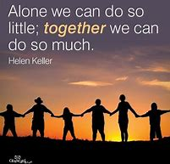
Building a Safer Community
As you all Continue working on the issues of Suicide Prevention and Restricting Lethal Means Remember !

Slide 29

Questions?

Slide 30
The End
Michael Barfield Ed.D, LSW
Clinical Program Director
Child and Adolescent Unit
Western Psychiatric Hospital
barfieldm@upmc.edu

Slide 31
References
Barber, C., & Miller, M. (2014). Reducing a suicidal person’s access to lethal means of suicide: A research agenda. American Journal of Preventive Medicine, 47(3S2), S264–S272.
Centers for Disease Control and Prevention, National Center for Health Statistics. (2021). 1999-2020 Wide Ranging Online Data for Epidemiological Research (WONDER), Multiple Cause of Death files [Data file]. Retrieved from http://wonder.cdc.gov/ucd-icd10.html
Centers for Disease Control and Prevention (CDC), Youth Risk Behavior Surveillance System. (2021). 1991-2019 High School Youth Risk Behavior Survey Data [Data file]. Retrieved from http://nccd.cdc.gov/youthonline/
Centers for Disease Control and Prevention, National Center for Health Statistics. (2021). 1999-2020 Wide Ranging Online Data for Epidemiological Research (WONDER), Multiple Cause of Death files [Data file]. Retrieved from http://wonder.cdc.gov/ucd-icd10.html
Suicide Prevention Resource Center. (n.d.). Counseling on access to lethal means (CALM). Retrieved from https://www.sprc.org/resources-programs/calm-counseling-access-lethal-means

